Slide 1

Highway Congestion: A Statistical Analysis
By: Rohan Gupta
Xu Wang

Slide 2
Scope of the Project
Traffic congestion is a problem faced by billions of people worldwide. A system to analyse and predict congestion and flow of traffic is thus extremely valuable.
Working under the assumption that a crowd of people utilising the highway will follow a predictable and statically relevant pattern, we examined the data for 4 highways over the course of 12 hours.
The results thus obtained will aim to provide a basis for further development of an algorithm to accurately predict traffic patterns.

Slide 3
Collection and Processing of Data
The data was pulled from The Freeway Performance Measurement (PeMS) System, an open-source database made by the California Traffic Management Centre.
The various relevant data needed for the project was processed using Excel and modelled using a combination of Minitab and Matlab.

Slide 4
Explanation of the Data
The data relates to a random Monday, in this case the 18th of November 2019. This date was chosen as it holds no specific significance of any kind.
A 5 mile stretch from each of the 4 highways was chosen, and 157 data points (one every 5 minutes for 12 hours) were created. For this project, we are concerned with Average Speed, Flow rate and Density.
A further explanation of the various data quantities will follow in the later stages of this presentation.

Slide 5
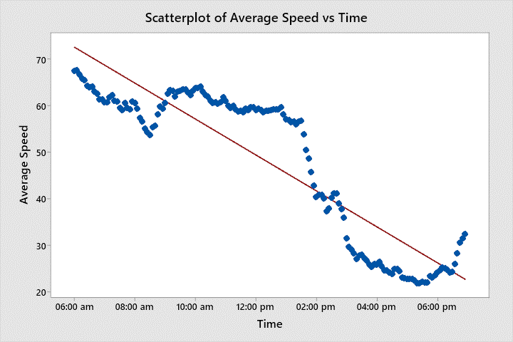
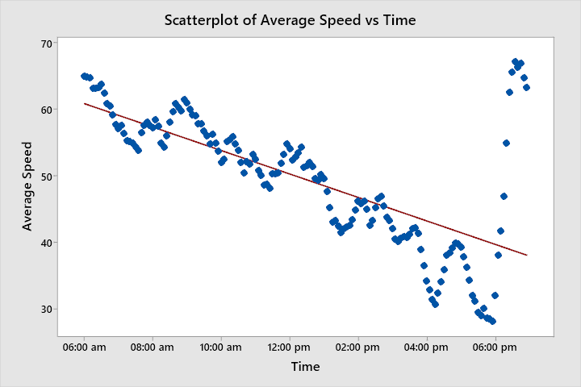
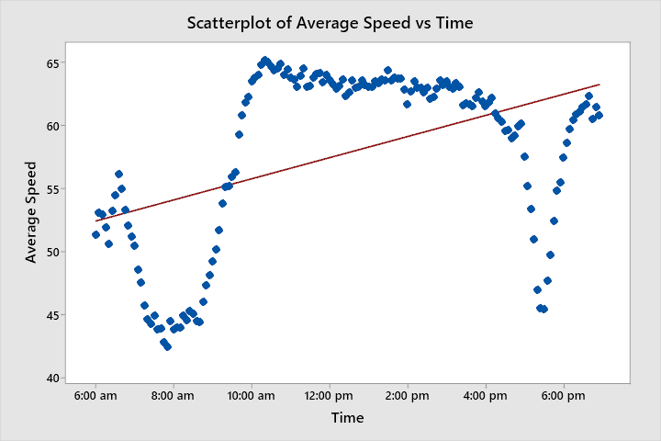
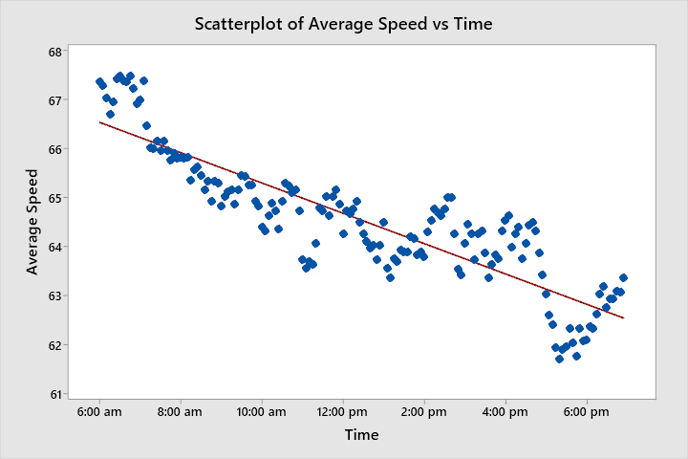
Scatterplot of Average Speed Vs Time
405 South
10 East
Shows the change in speed throughout the day.
I405 is an intracity highway
I10 is an intercity highway
405 North
10 West

Slide 6
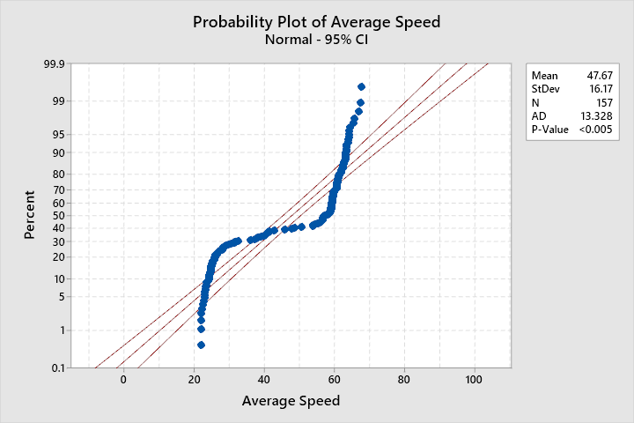
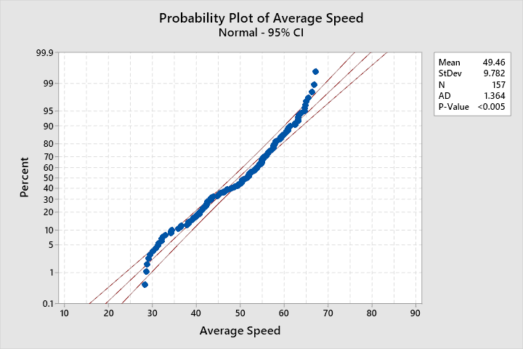
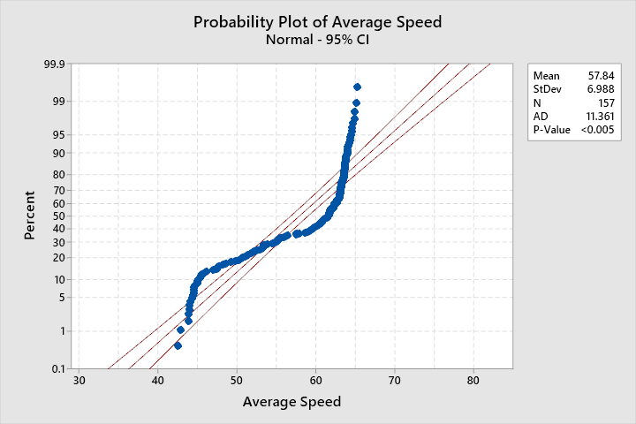
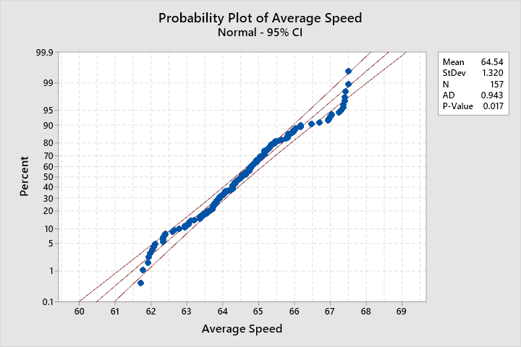
Probability Plot of Average Speed Vs Time
405 South
10 East
Shows that the average speed can be accurately modelled as a normal distribution.
405 North
10 West

Slide 7
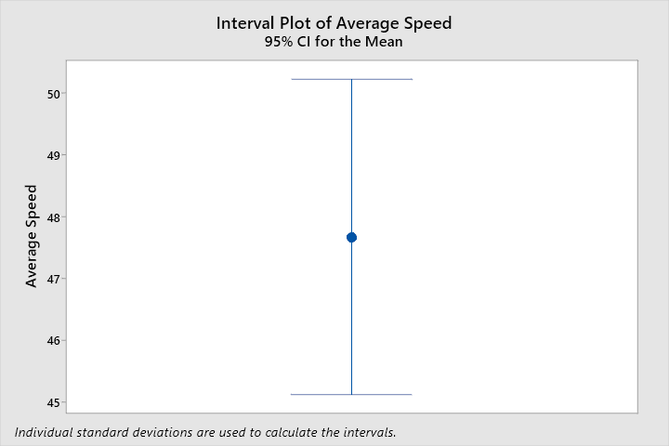
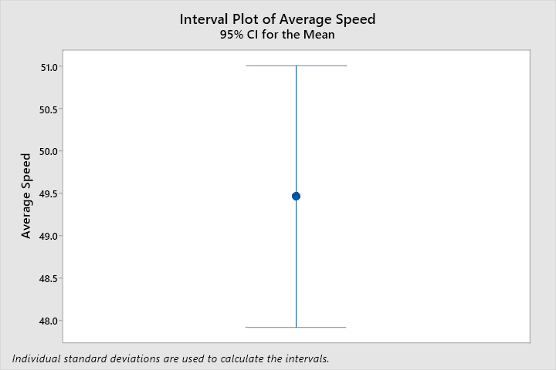
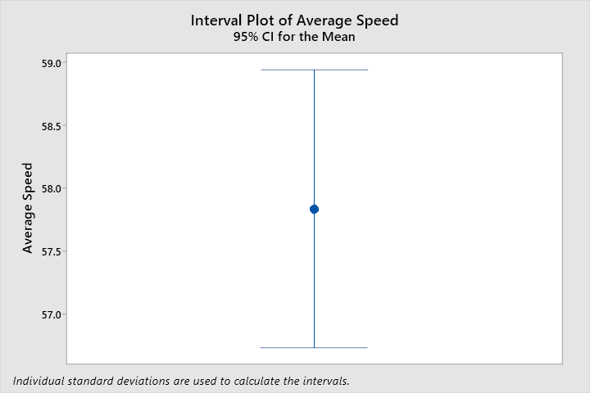
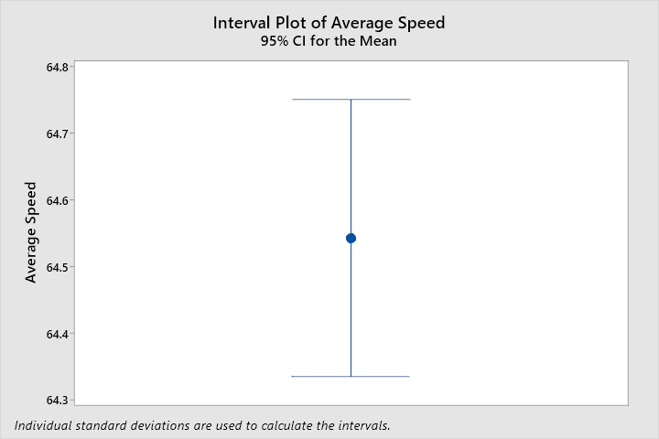
Interval Plot of Average Speed Vs Time
405 South
10 East
Shows that the average speed stays within 6σ of the mean.
Supports the normal distribution hypothesis
405 North
10 West

Slide 8
Normal Distribution of Average Speed
After examining the data, the conclusion was drawn that the traffic throughout the day could be modelled as a normal distribution. This will aid in predicting the congestion on any highway greatly.
By using the basic formulae attached to normal distribution, and judging congestion as being an average speed of less than 30 mph, the following conclusions were drawn:

Slide 9
Normal Distribution of Average Speed
For 405 South : Mean Speed = 47.67 Mph
: Standard Deviation = 16.17 Mph
: Probability of encountering congestion in the 12 hour day period = 13.8%
This figure can be similarly calculated using any period of time from 6:00 am to 6:00 pm, in five minute intervals.

Slide 10
Normal Distribution of Average Speed
Probability of encountering congestion from 2:00 pm to 2:05 pm on the I405 South
Mean Speed : 39.17 Mph
Standard Deviation : 5.30 Mph
Probability of Congestion : 4.18%

Slide 11
Three Phase Traffic Theory
Based on the vehicle speed of the previous part, we still could not decide the congestion degree of the highway.
Low speed doesn’t have to mean congestion. There exist situations that few cars drive slowly.
High speed doesn’t have mean free flow of traffic. There exist situations that many cars in a crowded highway move at same high speed.
11

Slide 12
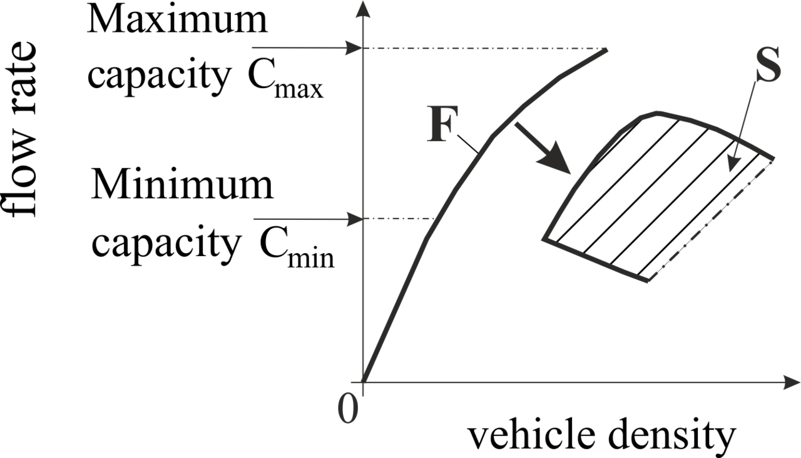
Three Phase Traffic Theory
State of highway, in flow rate-density relation,
The curve noted F above indicates free flow.
The shadow area noted S above indicates congestion, we call it congestion area in this talk.
Flow rate: passing vehicles per time
Density: vehicles per length
Occupancy: surrogate for density
12

Slide 13
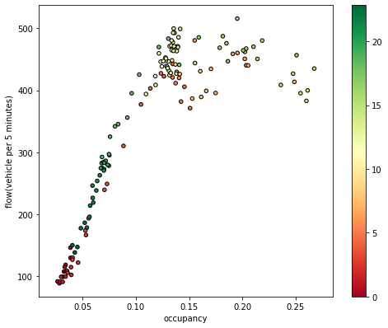
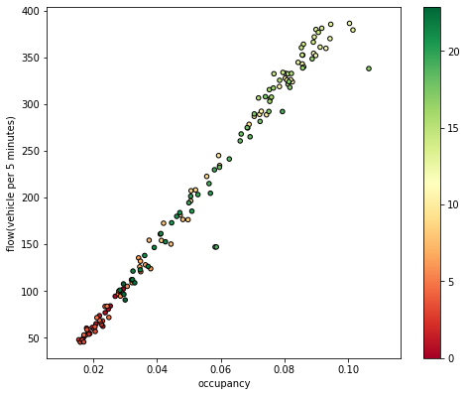
Scatter Plot of Highway Segment Samples
I10 West
I10 East
East direction of the highway has fluent traffic all day based on color by time while there are no distinct time zone for congestion in the west direction.
13

Slide 14
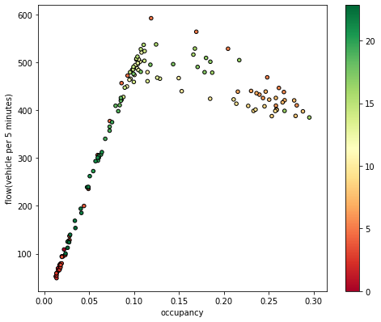
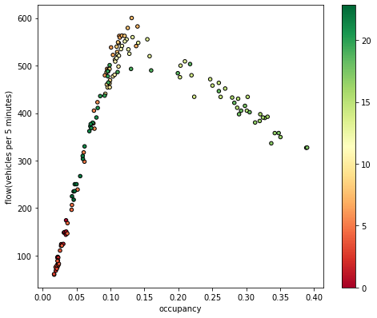
Scatter Plot of Highway Segment Samples
405 North
I405 South
When comparing the north and south directions of I405 highway, south direction has obvious ‘late peak’ while there is no distinctive congestion time zone for north part.
14

Slide 15
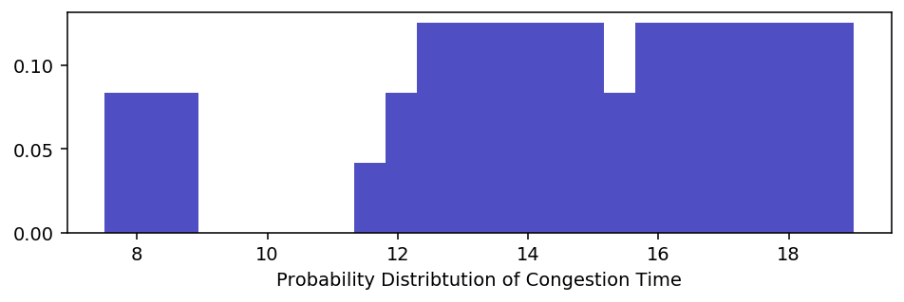
Probability Distribution of Congestion Time
Highway I405 south direction as mentioned.
Collect the flow and occupancy data of 1 week.
Within the points in congestion area in ‘occupancy-flow’ plot, here is the probability distribution of these points.
By the plot, there is one short abrupt peak around 8:00 AM in the morning and long-lasting congestion time zone during the whole afternoon.
15

Slide 16
Conclusion
Applying descriptive plots (including scatter plot, probability plot and etc) directly to the average speed of vehicles on a highway gives an overview of congestion. However, this is not the full picture.
After combining the data from descriptive tools with Three-Phase Traffic Theory, analyzing the congestion in the specified time zone for a sample highway yields better results.
Using the information from both, an accurate analysis can be made, which cab be used as the basis of a prediction model for traffic on any highway.

Slide 17
Thank You for your time.
17

